Slide 1

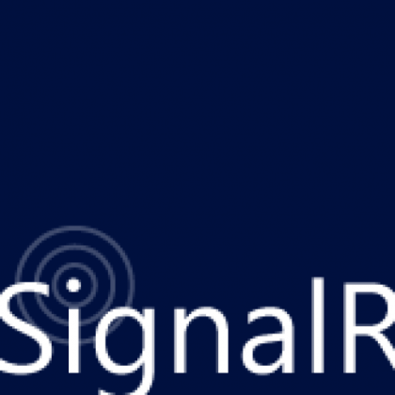


ASP.NET SignalR
Ivaylo Kenov
Technical Assistant
Telerik Software Academy

Slide 2

Table of Contents
Web-based real-time communication
Problems and solutions
ASP.NET SignalR - Overview & concepts
Hubs
Server-side API
Clients
Client-side API
Chat Live Demo

Slide 3

Web based real-time communication
Now, now and now!

Slide 4
Problems & Solutions
Users want data
Now & instant
Up-to-date
Delivered to any device, over any connection
Examples
Live searches/updates
Stock streamers, auctions
Live scores, betting, interactive games
Real-time feedback, real-time notifications

Slide 5
Problems & Solutions
Developers need to provide real time data
But not only for web applications
What about mobile devices & apps?
What about traditional desktop applications?
What about server-to-server?
Push communication beyond the web is a need
Think, design & implement Push Services

Slide 6

Push Services Pattern
Not official of course!

Slide 7
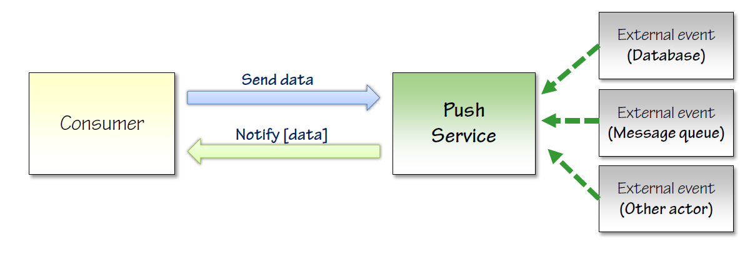
Push Services Pattern
Push Services are not an official pattern
Model a service that
accepts incoming connections from callers
is able to push data down to callers
abstracts from communication only details

Slide 8
HTTP Protocol
Web communication – HTTP!
Basically request-response
Realize Push services with HTTP
Periodic Polling
Long Polling
Forever Frame
Server-Sent Events (SSE)
Web Sockets

Slide 9
Web Sockets
Web Sockets – latest piece of technology!
Positives:
Easy
Constant connection
Send only small details
Negatives
Only with Windows 8/Server 2012
Network considerations
Maybe some time, but not today

Slide 10
Web Sockets
Live Demo

Slide 11
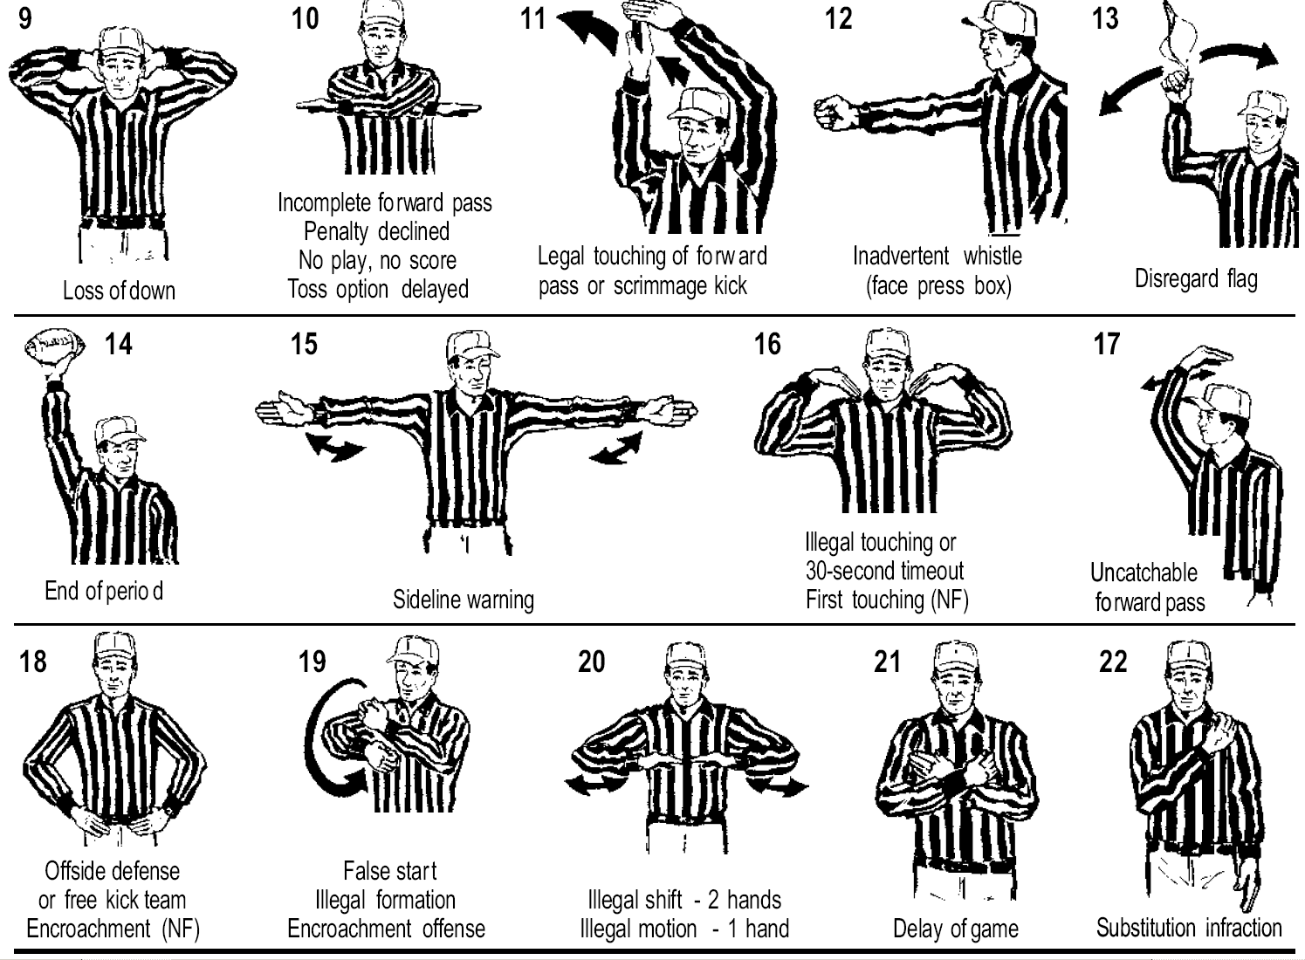
SignalR Solution
Part of ASP.NET but not tied to it!

Slide 12
SignalR
SignalR is:
A server-side framework to write push services
Clients for easy communication on any device
Optimized for asynchronous operations
Operation:
Persistent connection
Data is sent as signal through connection ID
Volatile, no-dirable

Slide 13
SignalR
Framework is based on Interfaces:
Programming modes:
Persistent connection
Hubs
Hubs offer predefined API for most scenarios
SignalR example:
http://shootr.signalr.net/

Slide 14
SignalR
Packages at NuGet:
Microsoft.AspNet.SignalR
Microsoft.AspNet.SignalR.Core
Microsoft.AspNet.SignalR.Owin
Microsoft.AspNet.SignalR.Js
Microsoft.AspNet.SignalR.Client
Microsoft.AspNet.SignalR.Utils

Slide 15
SignalR
Installation
Download Microsoft.AspNet.SignalR
In Global.asax register the hubs
Create directory Hubs
Add new SignalR classes to it
Done!
To update from 1.x to 2.0
RouteTable.Routes.MapHubs();

Slide 16
SignalR ShootR
Live Demo

Slide 17
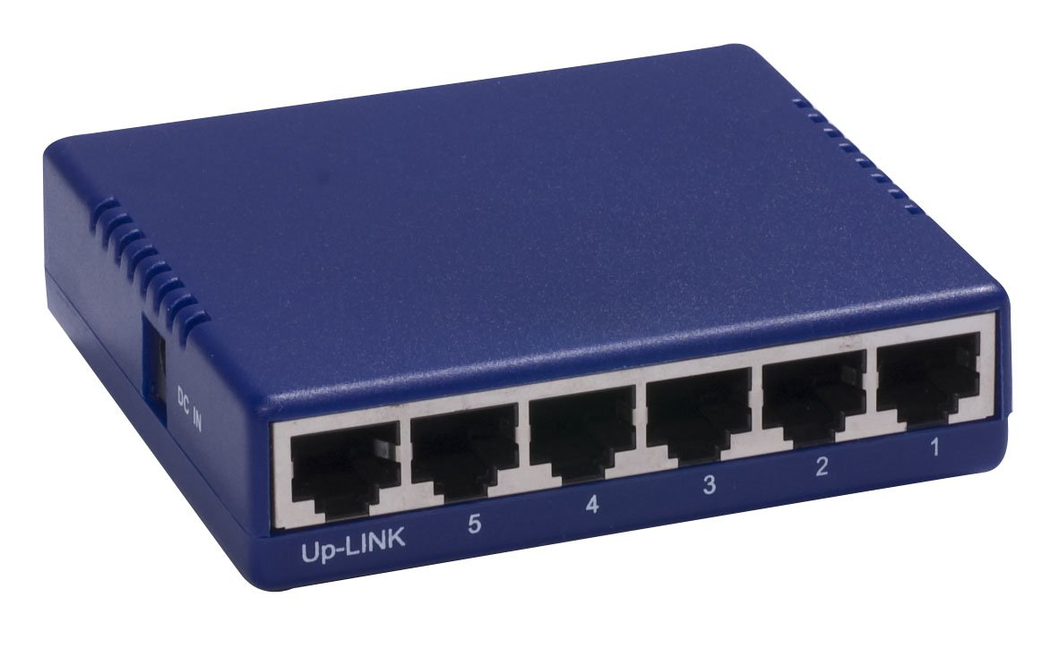
SignalR Hubs
Server-side

Slide 18
Hubs
Classes to implement push services
Abstraction on top of persistent connection
Convention over configuration
Perfect for sending data from server to clients
Conventions
Public methods are callable from clients
Send data by invoking client methods

Slide 19
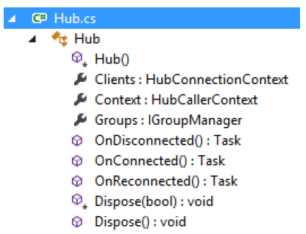
Hub Programming
Hub name reflected onto external API
Return simple type, complex type or Task
Objects and collection – automatically to JSON
Context
ConnectionId
Request
Headers
RequestCookies
QueryString
User

Slide 20
Hub Programming
Base endpoint is /signalr
JS metadata from /signalr/hubs
Basically two protocol steps
negotiate: which transport do you support?
connect: OK, here is my persistent connection
‘Best’ transport negotiation
W. Sockets -> SSE -> Forever frame -> L. polling
Any data is JSON encoded

Slide 21
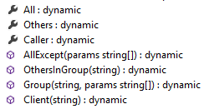
Clients Property
Clients property to send messages to clients
Holds dynamic properties and methods
Target method with parameters
Dynamically ‘injected’
Serialized
Embedded into response
public void SendMessage(string message)
{
var msg = string.Format("{0}: {1}", Context.ConnectionId, message);
Clients.All.newMessage(msg);
}

Slide 22
Groups Property
Groups - typical base pattern in push scenarios
Add connections to groups
And send messages to particular groups
Groups are not persisted on server!
public void JoinRoom(string room)
{
Groups.Add(Context.ConnectionId, room);
}
public void SendToRoom(string room, string message)
{
var msg = string.Format("{0}: {1}", Context.ConnectionId, message);
Clients.Group(room).newMessage(msg);
}

Slide 23
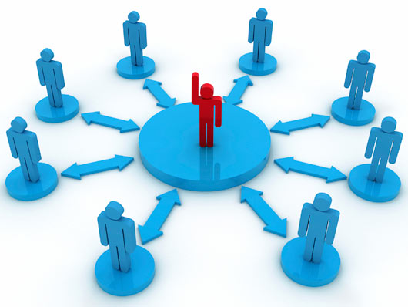
SignalR Clients
Client-side

Slide 24

Clients
Consumers
Client applications
Other services/hubs
SignalR provides a variety of client libraries
WinRT
Windows Phone 8
Silverlight 5
jQuery
C++

Slide 25
jQuery Client
Automatic proxy code via /signalr/hubs
Script generated based on hubs declaration
Hubs become properties on $.connection
Example $.connection.chatHub
Hub name camel cased
$.connection.hub.start() – start connection
$.connection.hub.start({ transport: 'longPolling'});
var chat = $.connection.chat;
chat.server.joinRoom('private');

Slide 26
jQuery Client
Define client side methods
They can be invoked by the hub
Events for connection state handling
Detect slow connections
Cross-domain support
var chat = $.connection.chat;
chat.client.newMessage = onNewMessage;
function addMessage(message) {
$('#messages').append(message);
}

Slide 27
Chat
Live Demo

Slide 28
ASP.NET SignalR
http://academy.telerik.com

Slide 29
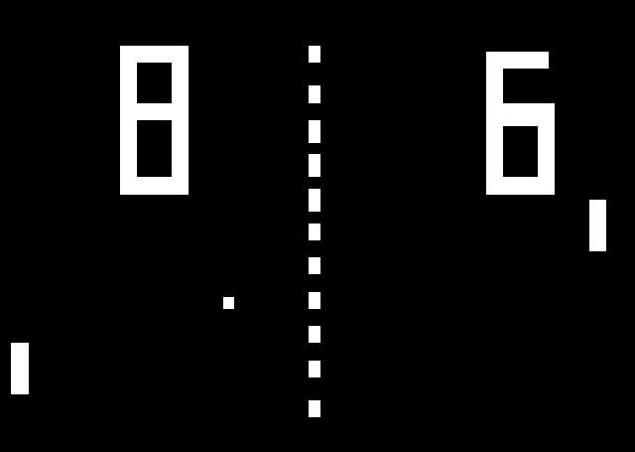
Homework
Create the Ping Pong game for two players with SignalR. You can use external libraries like CGWeb.

Slide 30
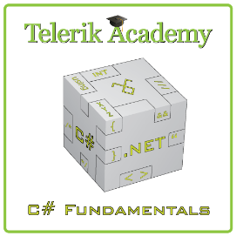


Free Trainings @ Telerik Academy
“C# Programming @ Telerik Academy
csharpfundamentals.telerik.com
Telerik Software Academy
academy.telerik.com
Telerik Academy @ Facebook
facebook.com/TelerikAcademy
Telerik Software Academy Forums
forums.academy.telerik.com

